Slide 1
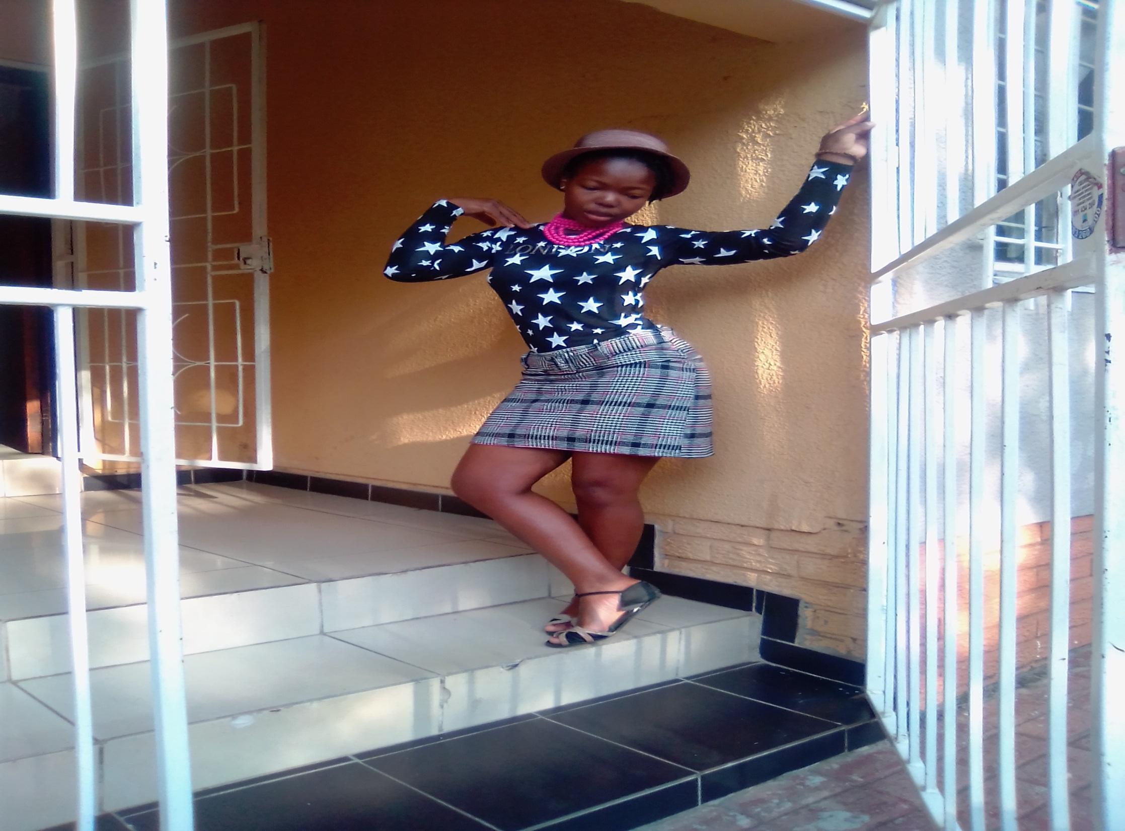

WELCOME TO NOKWANDA PROFILE
NOKWANDA THE JAI LADY
Notes:
WELCOME TO NOKWANDA PROFILE

Slide 2
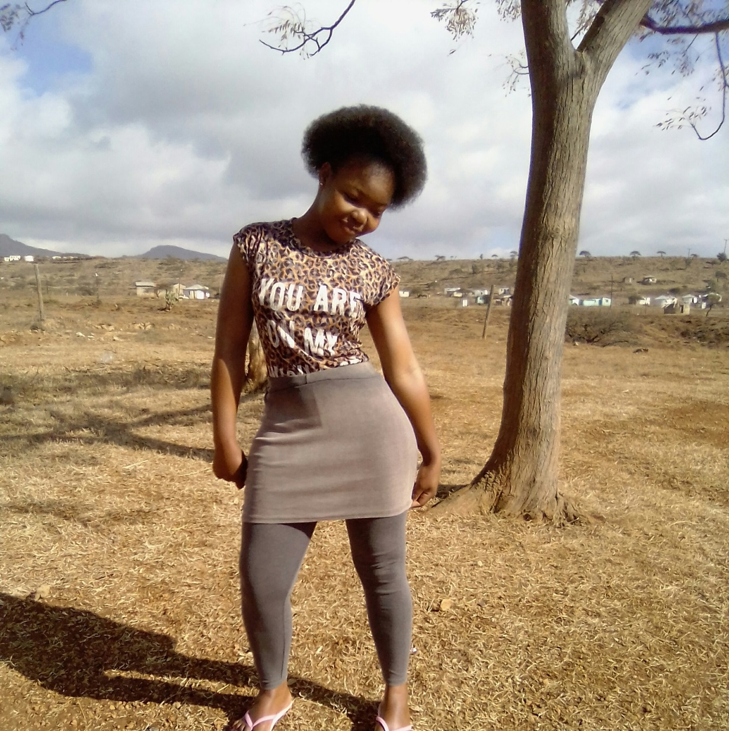
ABOUT MYSELF:INTRODUCTION
FULL NAME:Nokwanda Skhakhane
ADDRESS: 8493 Ext3 ORANGE FARM
CONSTACT: 0608454430
GENDER: FEMALE
LANGUAGE: ZULU
I am shy girl how like to stay indoors. I know my story and stand up for myself. I am carry kind to hard worker.
Notes:
“ZULU FOR LIFE”

Slide 3
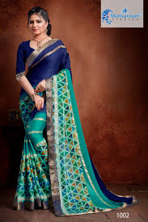
STRENGTH AND WEAKNESS
STRENGTHS
WEAKNESS
I CAN STAND FOR THE TRUTH.
GOOD AT COMMUNICATING WITH PEOPLE MOTIVATE THEM SPIRITAL AND FRIENDLY.
BEST WHEN COME TO KITCH STUFF MANAGE HOUSE.
DANGEROUS STUFF I MIX MYSELF WITH THEM.
SCARED OF ANIMALS WHEN COME ON TOUCH THEM/HOLD.
I CANNOT WALK IN DARK PLACES.
STAY WITH LOTS OF PEOPLE/EAT IN PUBLIC PLACE.
WEAR TROUSER IN PUBLIC (I DONOT FEEL COMFARTABLE)

Slide 4
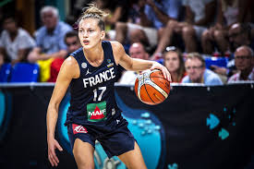
MY FAVOURITE SPORT
BASKETBALL :IT IS ARE SPORT THAT KEEP ME ON MOON.
THE BEST INTERESTING THUNGS ABOUT THIS SPORT DRIBBLING WAS NOT ALLOWED.
THE GAME IS MUCH SHORTER.
BASKETBALL IS PLAYED WITH DIFFERENT BALL.
REFEREES USED WATCHES.
BASKETBALL MADE ME FALL IN LOVE WITH IT BECAUSE IT FUN AND ENJOYABLE.
I LOVE BASKETBALL IS GREAT WAY TO EXERCISE AND A GREAT WAY TO HAVE FUN WITH FRIENDS AND POSSIBLE MAKE SOME NEW ONCES.
THIS SPORT CAN BE PLAY BY ANYONE.

Slide 5

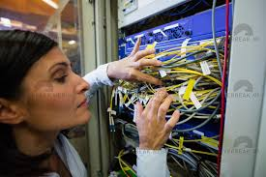
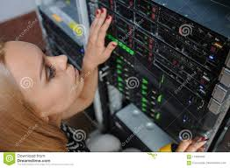
MY GOALS
ACHIEVE MY IT STUDIES.
FIND WORK
MANAGE MY LIFE(INDEPENDENT)
BUILD MY MOM HOUSE
DO MY COURSE ON MEDICE.
OPEN SMALL BUSINESS OF MY OWN
OPEN SOMETHING FOR THE KIDS IN MY COMMUNITY DEVELOP KZN.
CREATE NETWORK STRUCTUIRE.
Notes:
“I ONCE SAID NO MATTER WHAT I WILL BE INDEPENDENT SOON NO MATTER HOW IT TAKE THE BALL IS IN MY COURT”

Slide 6
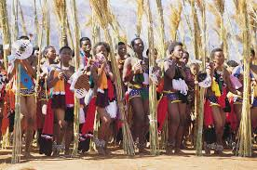
MY CULTURE:CONCLUSION
I AM ZULU(NATURAL ROOT)
I AM AFRICAN LADY.
WHAT I LIKE ABOUT ZULUS THEY HAVE RESPECT.
WE HAVE POWER TO DO WHAT WE WANT WITHOUT MAN ARROUND.
WE LIKE HOME MADE FOOD.
WE FOLLOW RED DANCE UNTILL A GIRL REACH AGE OF 21 WITHOUT BABY.
Notes:
“ABSTANANCE IS GO PATH THAT MANY YOUNG GIRLS FAIL “

